Slide 1
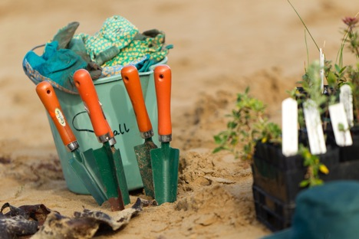
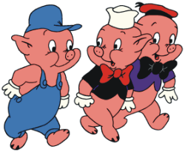
2015 State Community Landcare Conference
September 14-16, Waikerie, South Australia
The 3 little pigs: Connecting people with nature for ecosystem and human health and wellbeing
Matthew Ebden
Notes:
Wipe transitions with pictures and captions
(Basic)
To reproduce the picture effects on this slide, do the following:
On the Home tab, in the Slides group, click Layout, and then click Blank.
On the Insert tab, in the Images group, click Picture. In the Insert Picture dialog box, select a picture and then click Insert.
Select the picture. Under Picture Tools, on the Format tab, in the Size group, click the Size and Position dialog box launcher. In the Format Picture dialog box, resize or crop the image so that the height is set to 4” and the width is set to 10”. To crop the picture, click Crop in the left pane, and in the right pane, under Crop position, enter values into the Height, Width, Left, and Top boxes. To resize the picture, click Size in the left pane, and in the right pane, under Size and rotate, enter values into the Height and Width boxes.
Also in the Format Picture dialog box, click Shadow in the left pane, in the Shadow pane, click the button next to Presets, and then under Inner click Inside Top.
Also in the Format Picture dialog box, click Glow and Soft Edges in the left pane, in the Glow and Soft Edges pane, under Glow, do the following:
Click the button next to Color, click More Colors, and then in the Colors dialog box, on the Custom tab, enter values for Red: 157, Green: 177, and Blue: 91.
In the Size box, enter 8 pt.
In the Transparency box, enter 60%.
To reproduce the text effects on this slide, do the following:
On the Insert tab, in the Text group, click Text Box, and then on the slide drag to draw your text box.
Enter text in the text box, and then select the text. On the Home tab, in the Font group, do the following:
In the Font list, select Calibri.
In the Font Size list, select 24 pt.
Click the Font Color, and then under Theme Colors click White, Background 1 (first row).
Click Italic.
Position the text box below the picture.
To reproduce the transition effects on this slide, do the following:
On the Transitions tab, in the Transition to This Slide group, click More, and then click Wipe.
Also on the Transitions tab, in the Transition to This Slide, click Effect Options, and then click From Right.
Also on the Transitions tab, in the Timing group, do the following:
In the Duration box, enter 2.00 seconds.
Clear the On Mouse Click box.
Select After, and then in the After box enter 3.00 seconds.
To reproduce the second, third, and fourth slides, do the following:
In the Slides pane, select the slide. On the Home tab, in the Slides group, click the arrow below New Slide, and then click Duplicate Selected Slides. Repeat this process until there are three slides.
On the slide, select the picture. Under Picture Tools, on the Format tab, in the Adjust group, click Change Picture. In the Insert Picture dialog box, select a picture and then click Insert.
In the Slides pane, select the third slide.
On the slide, select the picture. Under Picture Tools, on the Format tab, in the Adjust group, click Change Picture. In the Insert Picture dialog box, select a picture and then click Insert.
To reproduce the background on this slide, do the following:
On the Design tab, in the Background group, click Background Styles, and then click Style 12 (third row).
(Note: Selecting this background changes the colors on the slide.)

Slide 2
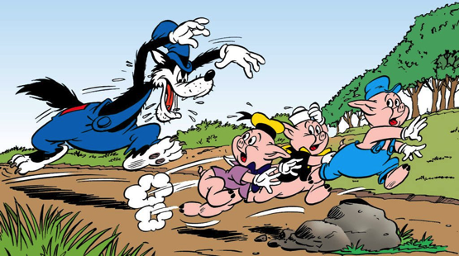
Starring
three little pigs
&
big bad wolf
Notes:
Landcare provides opportunities for social networking and connections.

Slide 3
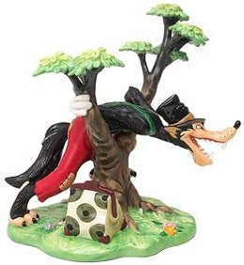
Notes:
Landcare provides opportunities for social networking and connections.

Slide 4
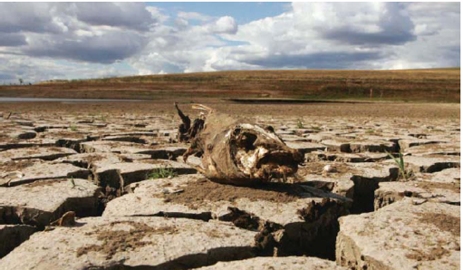
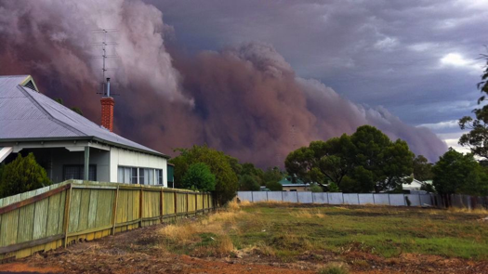
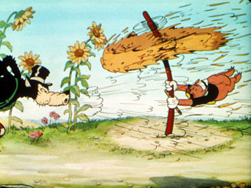
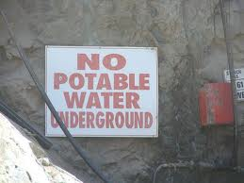
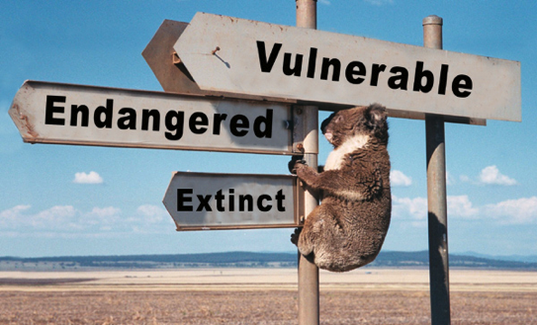
Notes:
Landcare provides opportunities for social networking and connections.

Slide 5
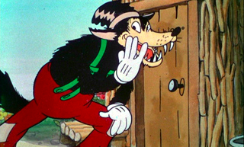
Notes:
Landcare provides opportunities for social networking and connections.

Slide 6
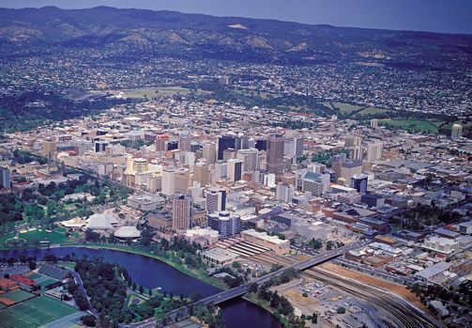
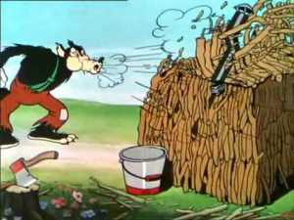
Notes:
Landcare provides opportunities for social networking and connections.

Slide 7
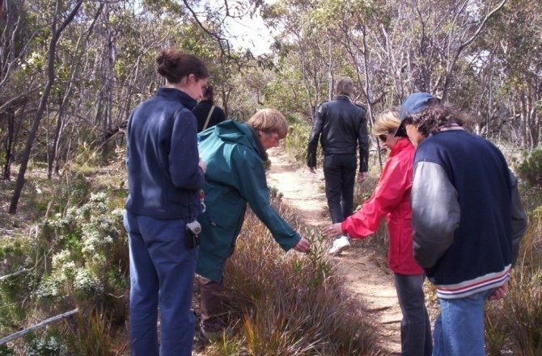
Feel Blue Touch Green
Notes:
Landcare provides opportunities for social networking and connections.

Slide 8
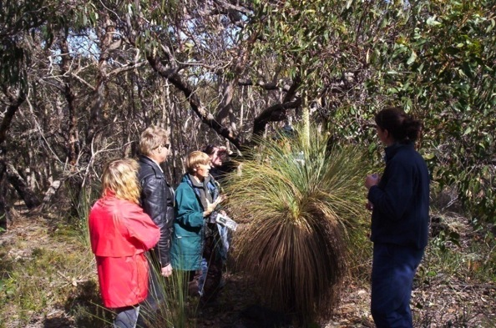
I need natural environments to maintain [my mental] health. I’ve had it with support groups and counsellors….
Notes:
Landcare provides opportunities for social networking and connections.

Slide 9
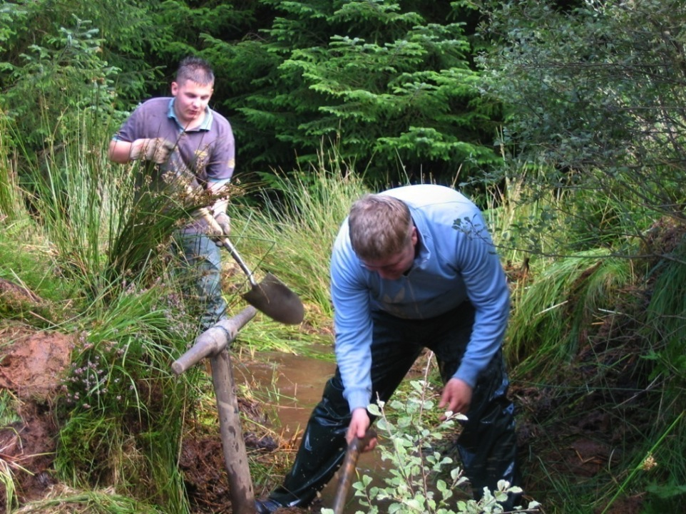
Environmental volunteering:
Motivations, barriers and benefits
Notes:
Landcare provides opportunities for social networking and connections.

Slide 10
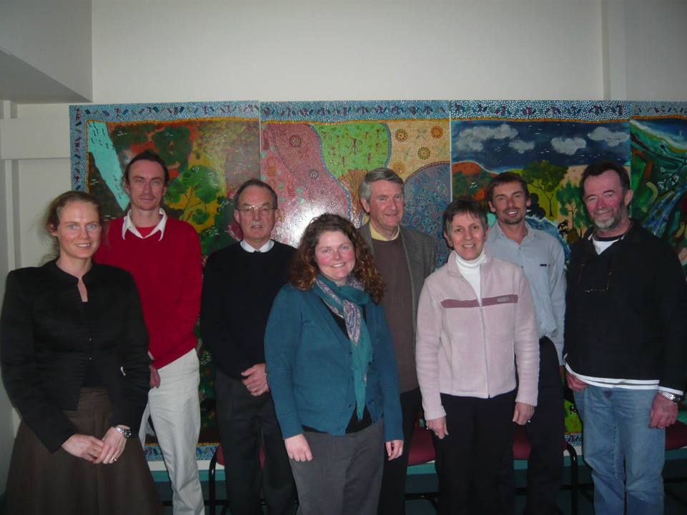
Community collaboration for social inclusion
in environmental volunteering
Notes:
Landcare provides opportunities for social networking and connections.

Slide 11
Environmental agencies
Health and community services
Volunteer Organisations
Educational institutions
Corrections departments
Local governments
Media
Transport providers
Funding bodies
Indigenous organisations
Employment agencies
Community
collaboration
Notes:
Landcare provides opportunities for social networking and connections.

Slide 12
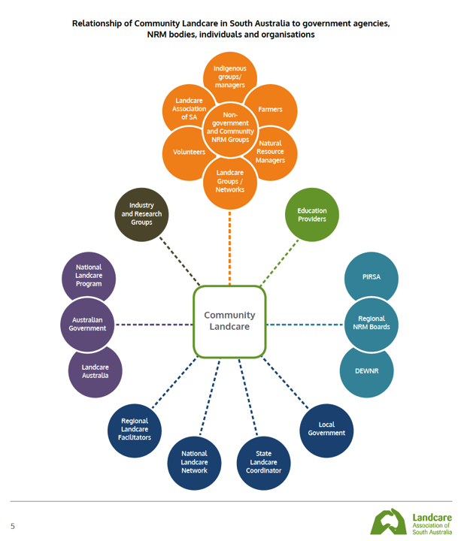
￼South Australian Community Landcare Plan 2014-2019

Slide 13
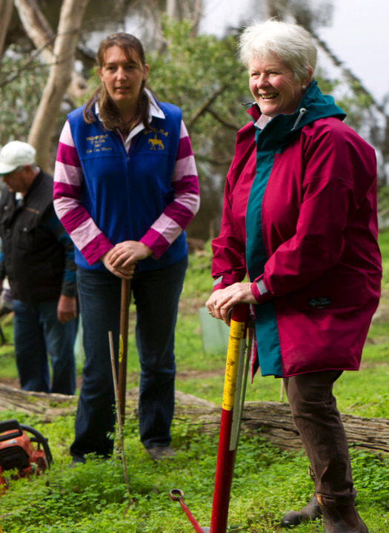
Employment agencies
Health and community services
Indigenous organisations
Volunteer Organisations
Funding bodies
Corrections departments
Transport providers
Media
South Australian Community Landcare Plan 2014-2019

Slide 14
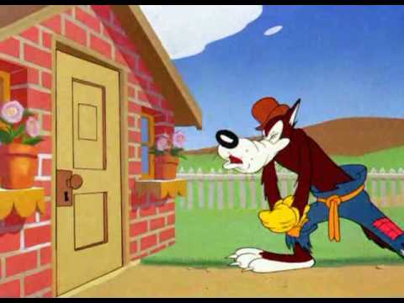
Notes:
Landcare provides opportunities for social networking and connections.

Slide 15
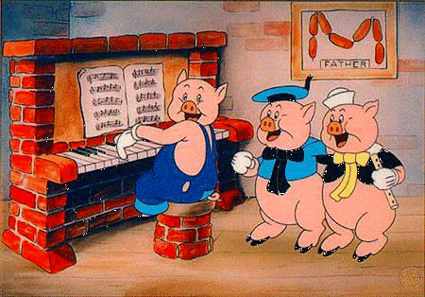
Notes:
Landcare provides opportunities for social networking and connections.

Slide 16
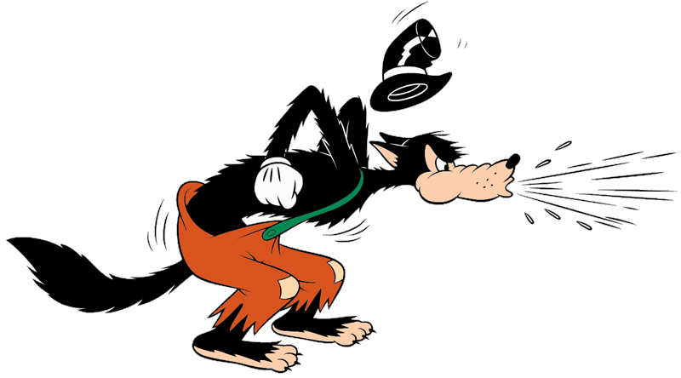
What did the big bad wolf represent?
Notes:
Landcare provides opportunities for social networking and connections.

Slide 17
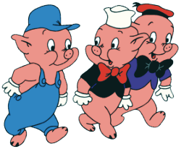
What did the three little pigs represent?
Notes:
Landcare provides opportunities for social networking and connections.

Slide 18
Who’s afraid of the big bad wolf?
“Who’s afraid of the big bad wolf?
The big bad woof?
The big bad woof?
Who’s afraid of the big bad wolf?
When we have each other,
And we share with our brother.
Who’s afraid of the big bad wolf?
When listen to others,
And learn from our mothers.
Who’s afraid of the big bad wolf?
When we get involved,
It’s a sight to behold.
Who’s afraid of the big bad wolf?
When we care for our planet,
It’s as solid as granite.
Who’s afraid of the big bad wolf,
Not you nor I,
Good bye big bad wolf!
Notes:
Landcare provides opportunities for social networking and connections.

